Slide 1
C Lab Project Quiz Game
Members:
Refah Rafia Islam - 170041051
Nusrat Jahan Rani - 170041044
Fardifa Fathmiul Alam - 170041060

Slide 2
Summary
A quiz has been made with general knowledge based questions.
Each correct answer leads the player to the next level with a specific amount of money won.
If the player gives any wrong answer, the game will be over and he/she wins the total money from the previous correctly answered questions.

Slide 3
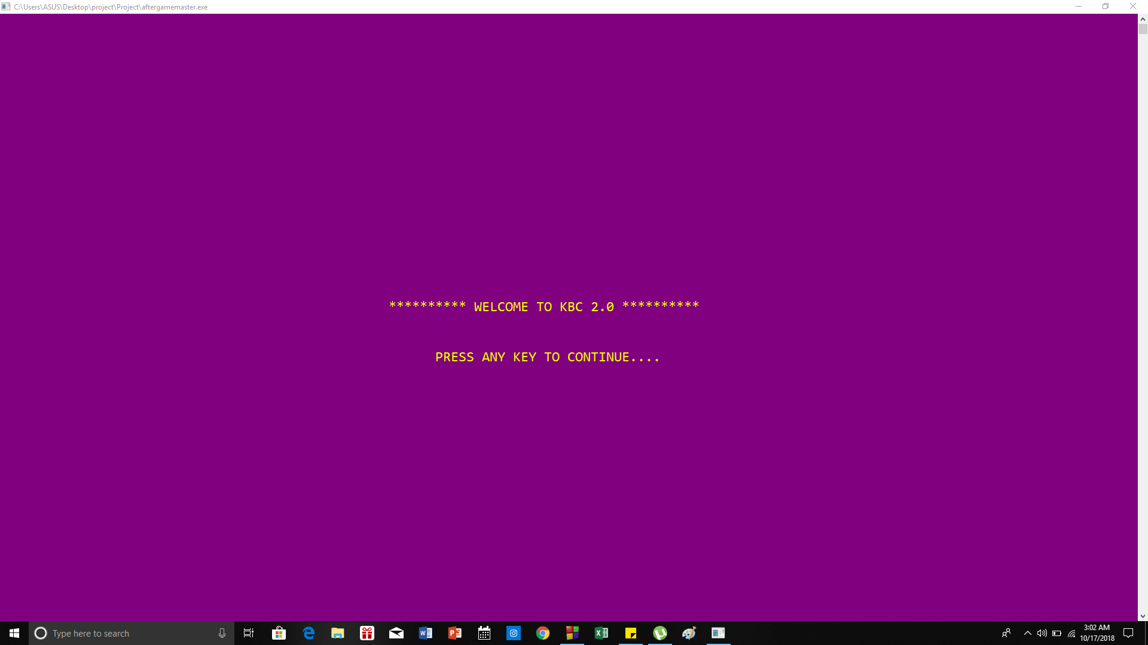

Slide 4
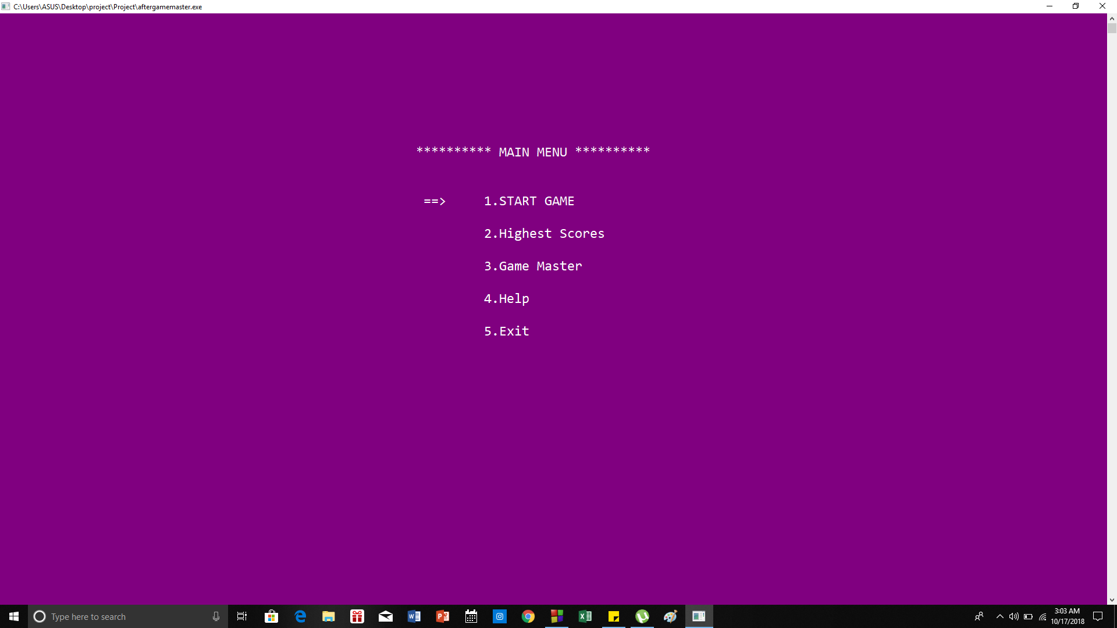

Slide 5
Main Features of the Game
1. Number of Levels:
There will be 20 levels , each consisting of 10 questions.
The difficulty level will be higher after every level.
2. Main Game:
The quiz game will be in the multiple choice question
format . Each correct answer will take the participant to
the next question and any wrong answer will break the
game and the users will get the results likewise. The
questions will be taken from a file.

Slide 6
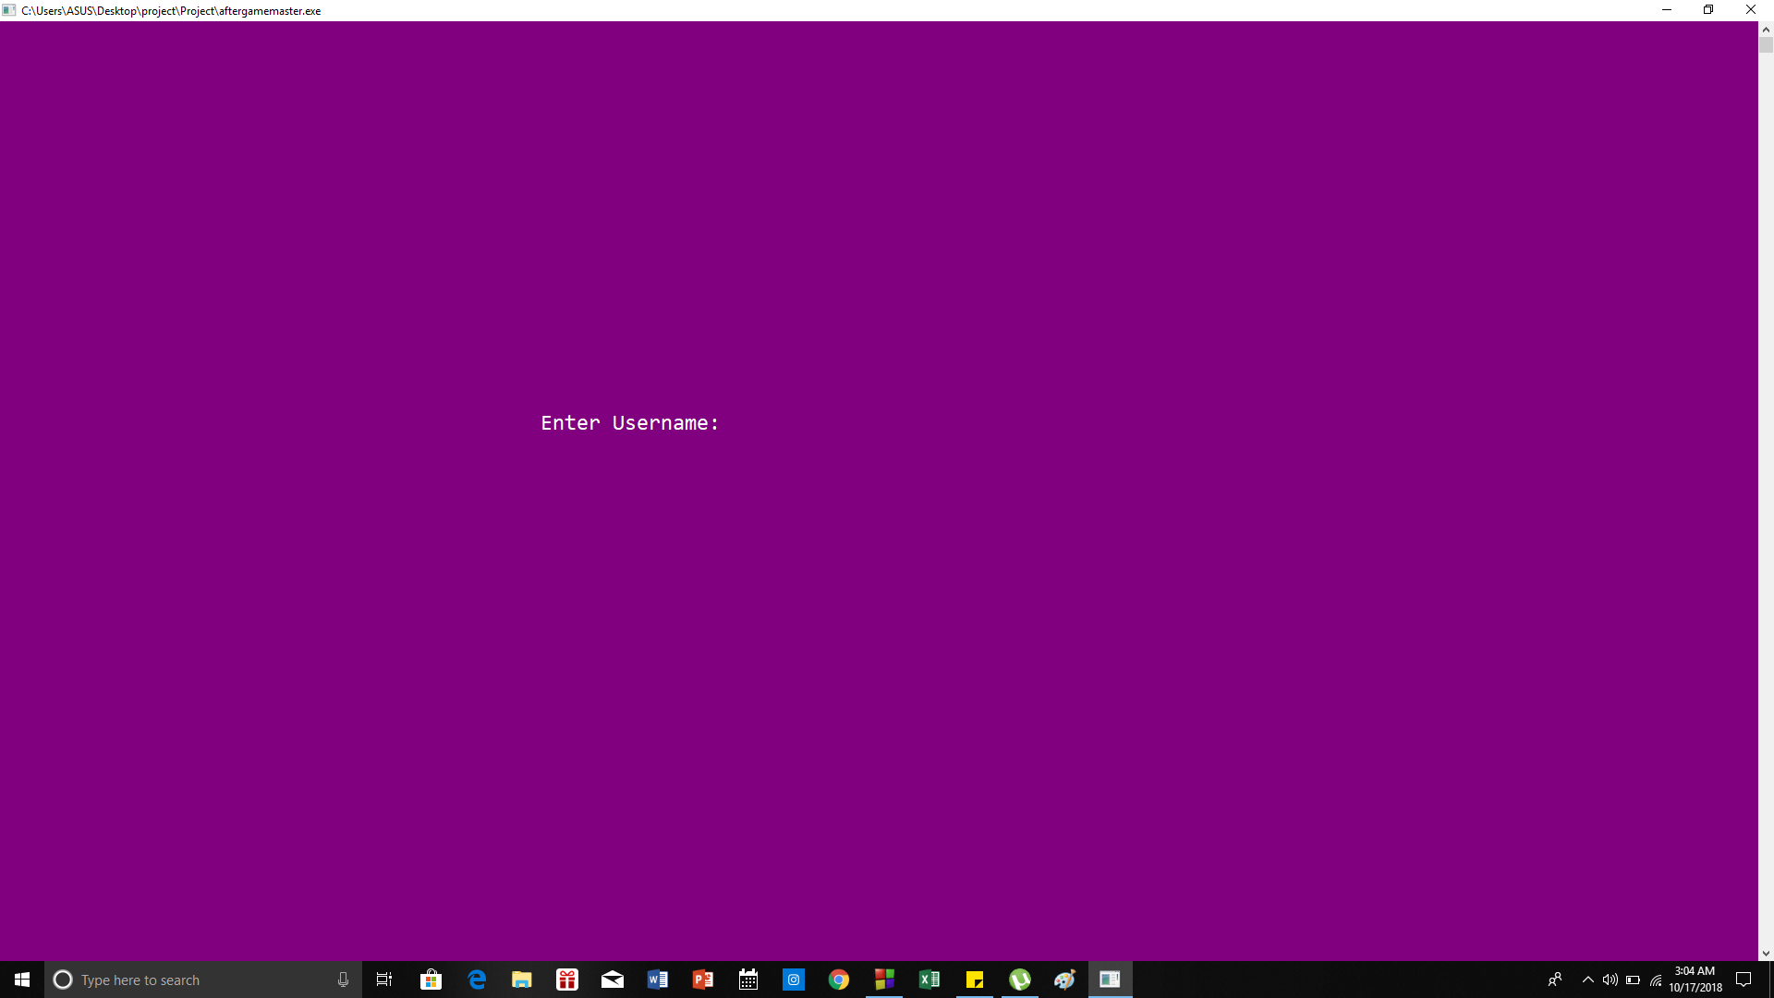

Slide 7
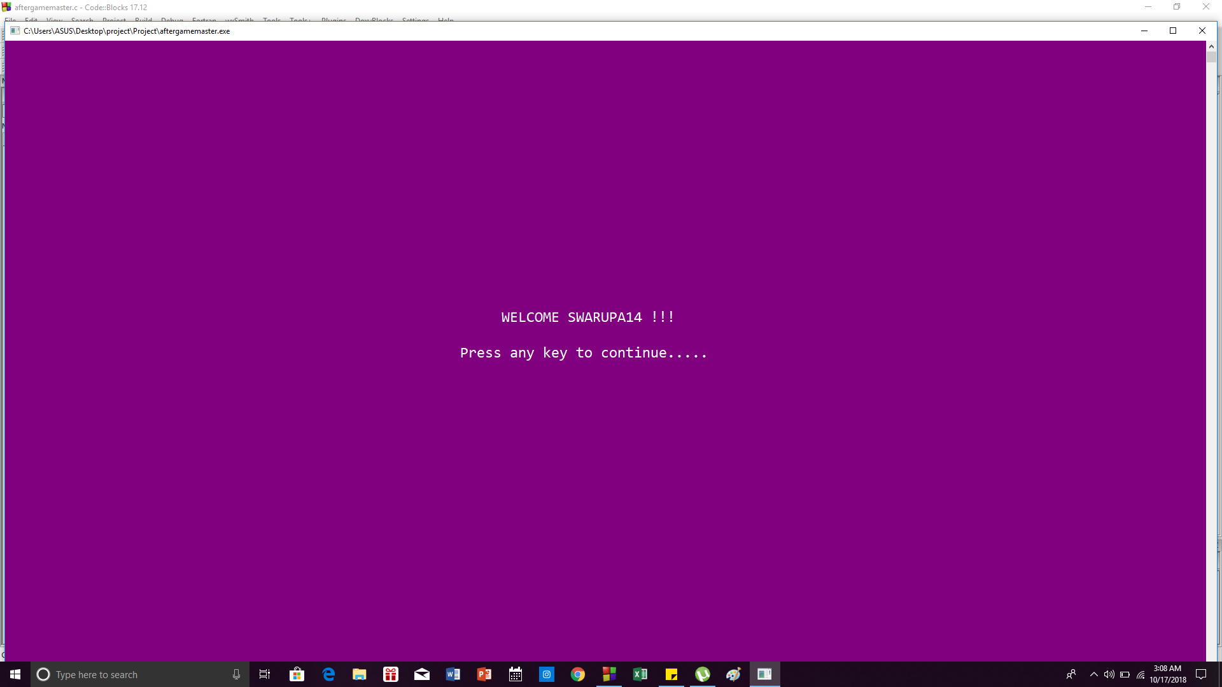

Slide 8
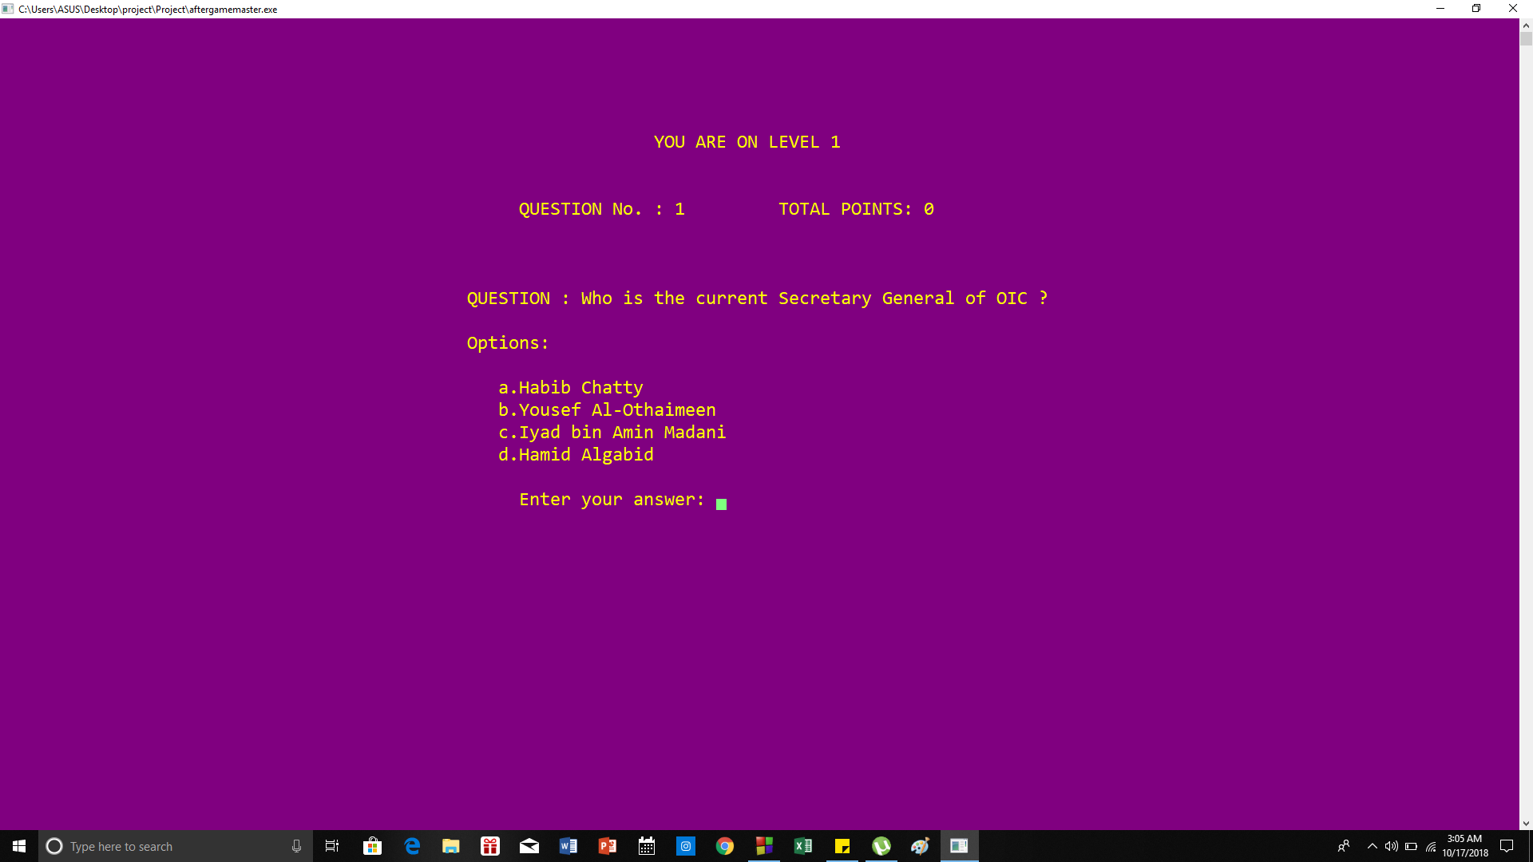

Slide 9
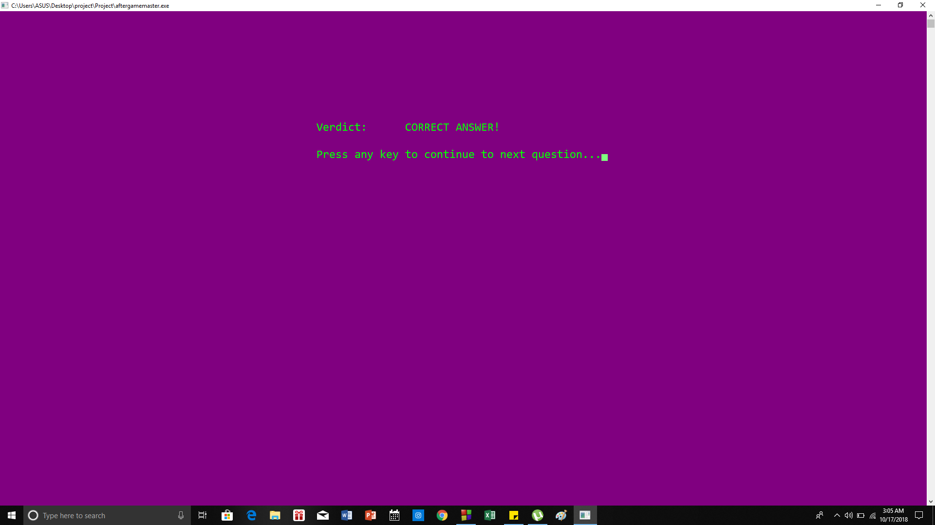

Slide 10
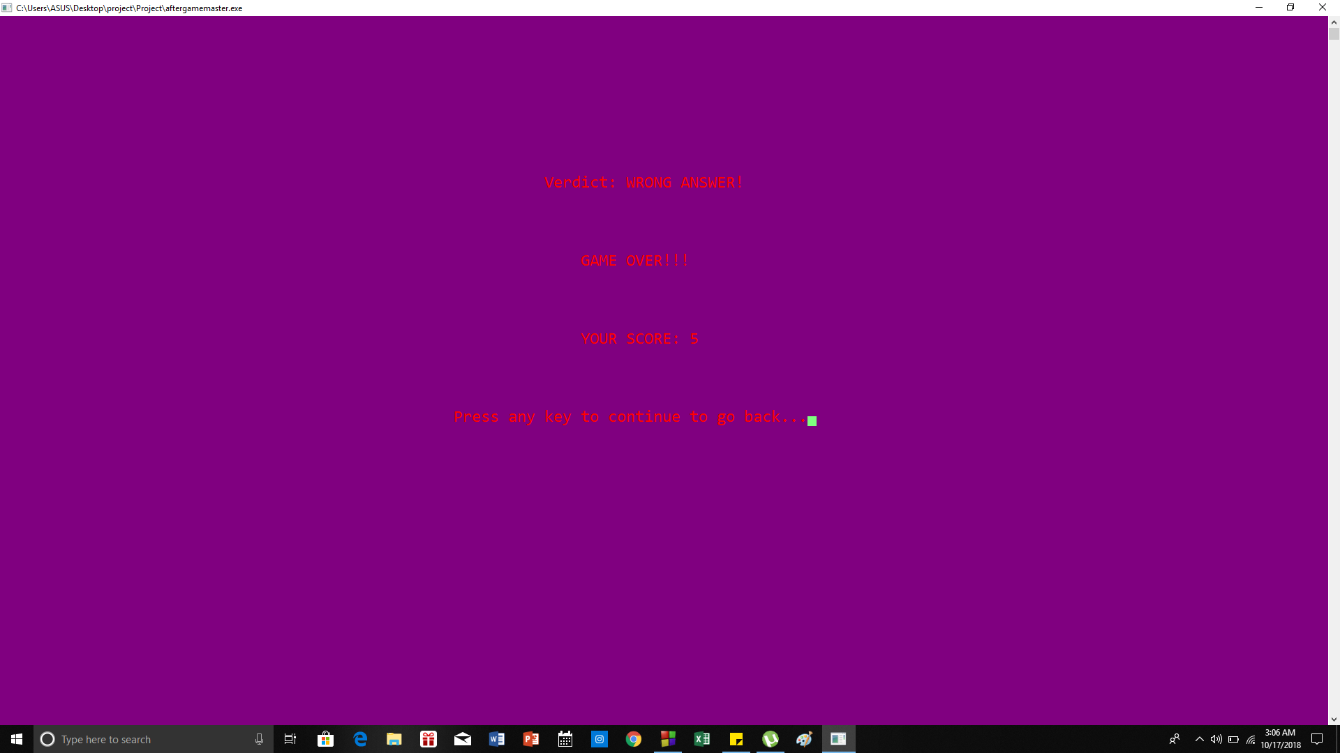

Slide 11
Main Features of The Game
3. Highest Scores:
The highest scores with the player name will be sorted
and shown in the highest scores leaderboard.
4. Gamemaster:
A gamemaster feature has been added to the game so
that questions can be added which will bring variety to the
game and remove monotony. The gamemaster can login
with a password. Not everyone will be able to access it.

Slide 12
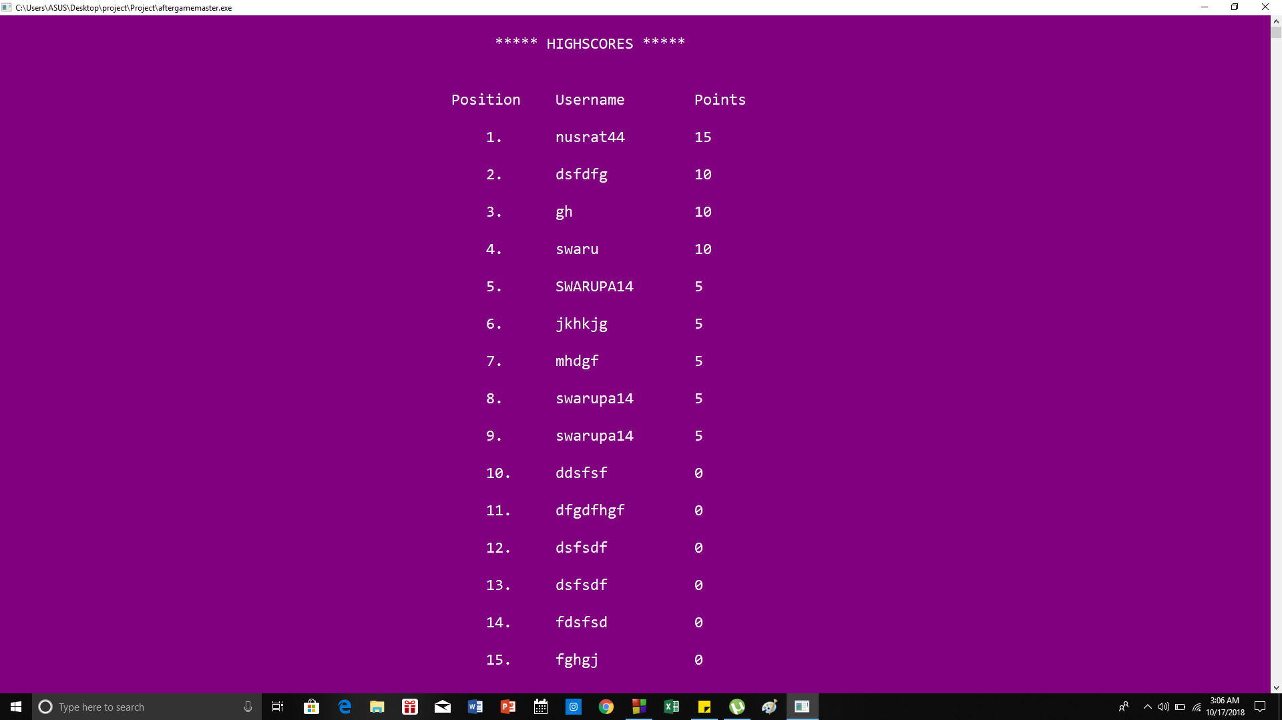

Slide 13
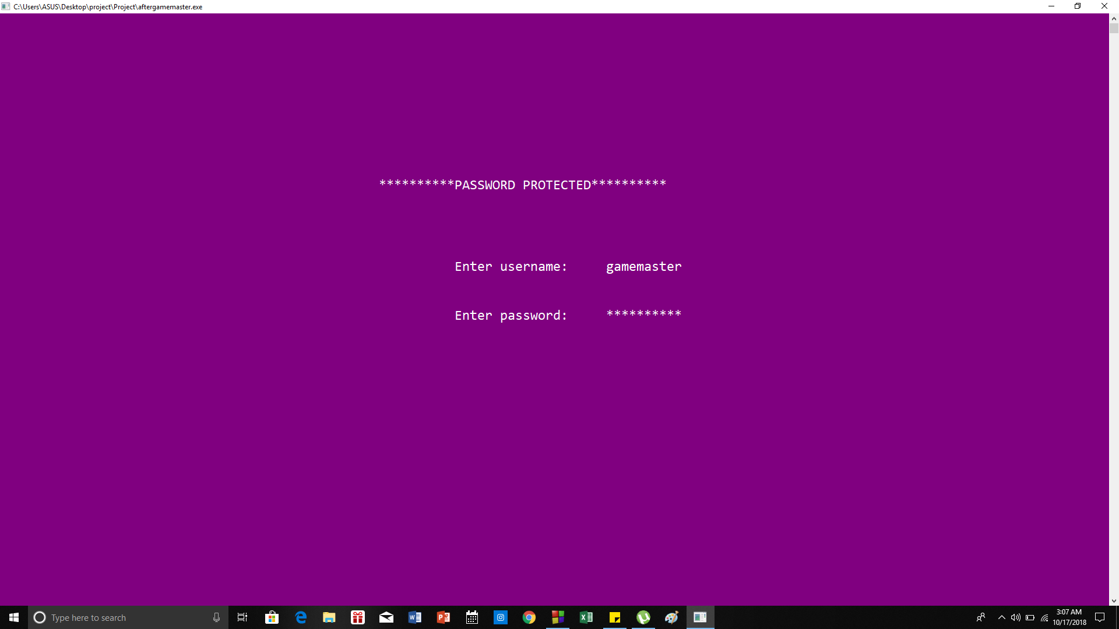

Slide 14
Main Features of The Game
5. Help
An instruction manual will be given to the player to help
them to play the game.

Slide 15
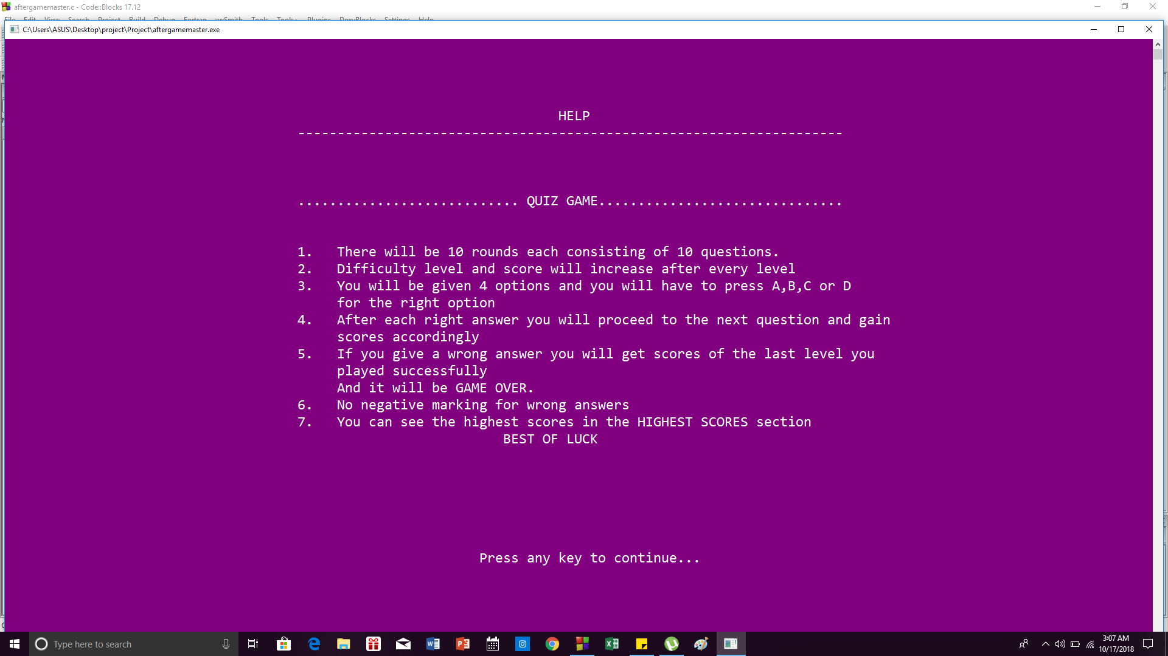

Slide 16
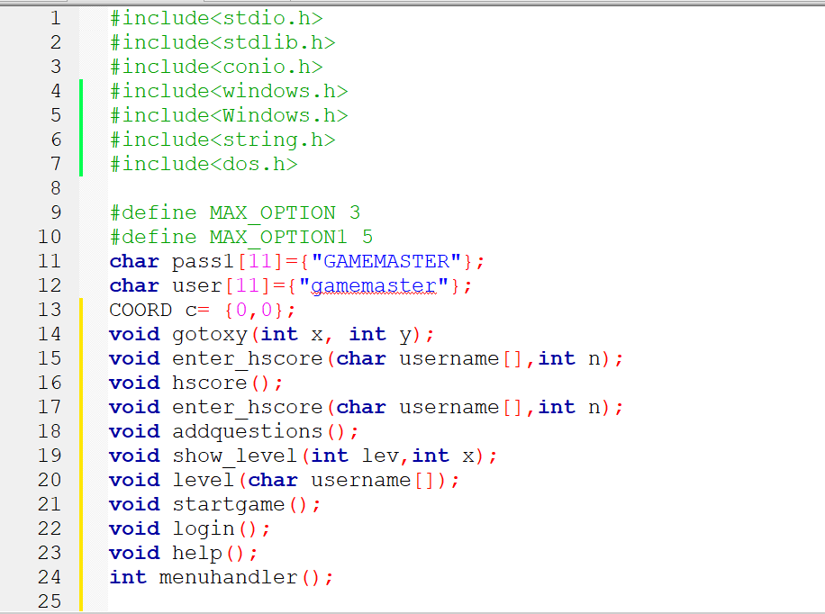

Slide 17
Thank You

